Slide 1
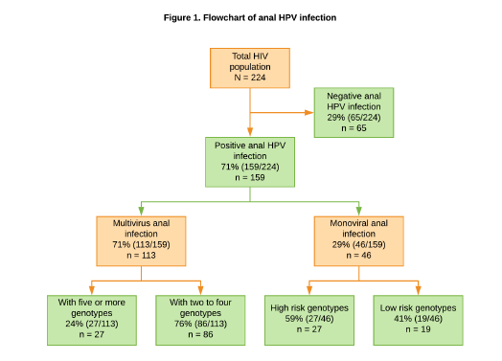
Prevalence and Characteristics of Anal Papillomavirus Infection in a Cohort of HIV-positive Men Who Have Sex with Men in Lima, Peru
Jaime A. Collins¹, Miriam Soria², Raúl Castillo¹, Oscar Malpartida¹, David Cerrón³, José Ballena³, Ricardo Illescas¹.
¹:Infectious Diseases Service. ²:Cytopathology and Genetics Service. ³:Infectious Disease Fellow. Guillermo Almenara Hospital, EsSalud, Lima, Peru.
Background
Human papillomavirus (HPV) is associated with anal cancer, which is more common in HIV-positive people.
However, there is little data on anal papillomavirus infection in HIV-positive men in our country.
Objective
To determine the prevalence and characteristics of anal HPV infection in HIV-positive men who have sex with men (MSM).
Method
Prospective cross-sectional observational study of HIV-positive MSM at our center between September 2017 and December 2018.
HPV detection and typing was performed using a polymerase chain reaction technique that evaluated 21 genotypes:
Six low-risk: 6, 11, 42, 43, 44 and 81 and
15 high-risk: 16, 18, 31, 33, 35, 39, 45, 51, 52, 53, 56, 58, 59, 66 and 68.
Conclusions:
HPV anal infection in HIV-positive MSM is very high in our center.
Infection with multiple HPV genotypes is the rule.
The distribution of papillomavirus genotypes is similar to that of other series or regions.
These findings emphasize the importance of vaccination against papillomavirus in HIV-positive carriers, especially MSM, to prevent anal cancer.
PRESENTED AT THE 23RD INTERNATIONAL AIDS CONFERENCE (AIDS 2020) | 6-10 JULY 2020

